Slide 1
ABAP Part II
Lesson 05: LSMW

Slide 2
Lesson Objectives
After completing this lesson, participants will be able to -
Use LSMW Data Transfer

Slide 3
LSMW - Introduction
Legacy System Migration Workbench
An R/3-based tool that supports when transferring data from non-SAP systems ("Legacy Systems") to SAP systems once or periodically
The tool supports conversion of data of the legacy system in a convenient way.
The data can then be imported into the SAP system via batch input, direct input, BAPIs or IDocs.
The LSM Workbench provides a recording function that allows generating a “data migration object” in an entry or changing transaction

Slide 4
Basic Principles of the LSMW
The LSM Workbench was developed on the basis of the R/2- R/3 Migration Workbench
LSMW was developed on the following principles
Most of the functions should reside in the SAP system. No collection of individual programs on different platforms.
The quality and consistence of the data imported into the SAP system should be more important than speed and performance of data migration.
Existing knowledge and coding should be used.
The developed "mapping" and rules should be reusable and thus be used repeatedly in projects.

Slide 5
Advantages of LSMW
It is a part of the SAP system and thus independent of individual platforms
A variety of technical possibilities of data conversion:
Data consistency due to standard import techniques
Generation of the conversion program on the basis of defined rules
Clear interactive process guide
Interface for data in spreadsheet format
Creation of data migration objects on the basis of recorded transactions

Slide 6
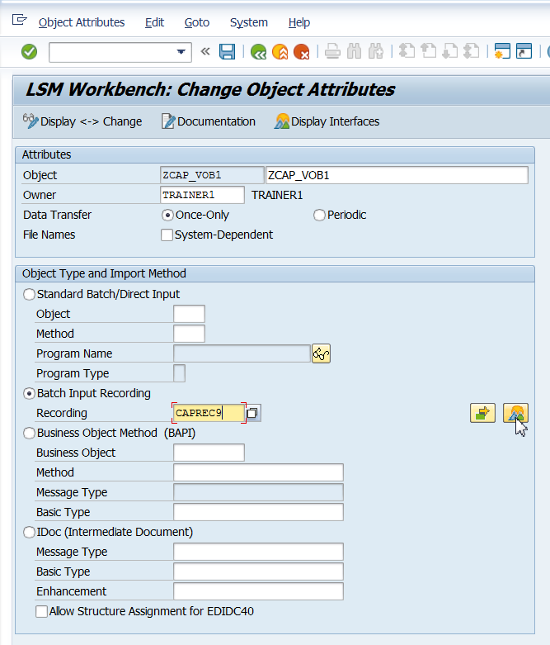
LSMW Import Methods
IDOC’s
BAPI’s
Standard/Direct Input
Batch Input
Notes:
1.IDOC’s
Advantages: Fast to load, easy processing, low programming for standard IDOC’s
Disadvantages: Good knowledge of IDOC processing required, time consuming if changes have to be made to a created IDOC
2. BAPI’s
Advantages: Fast to load, easy processing, logical interface for functional/end user based on the business processes involved.
Disadvantages: Not always complete with all input fields of a transaction
3. Standard/Direct Input
Advantages: Well tested method, Fast to load, easy processing.
Disadvantages: No enjoy transactions, not always complete with all input fields of a transaction.
4. Batch Input
Advantages: Easy modifiable, all fields are available, easy re-processing.
Disadvantages: Comparatively slow, to use new screens or tabs a new recording has to be created, not easily usable for enjoy transactions, dependant on user settings, difference in foreground and background processing may occur.

Slide 7
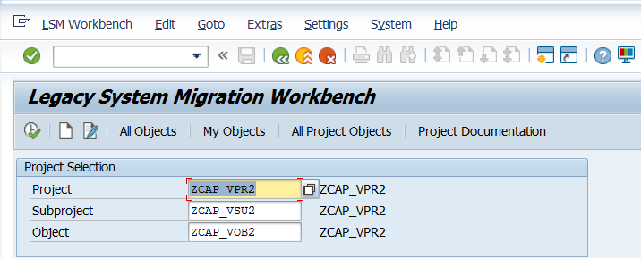
Steps involved in LSMW
Start Transaction Code LSMW
Notes:
Project: An ID with a maximum of 10 characters to name your data transfer project. If you want to transfer data from several legacy systems, you may create a project e.g. for every legacy system
Subproject: An ID with a maximum of 10 characters that is used as further structuring attribute
Object: An ID with a maximum of 10 characters to name the business object.

Slide 8
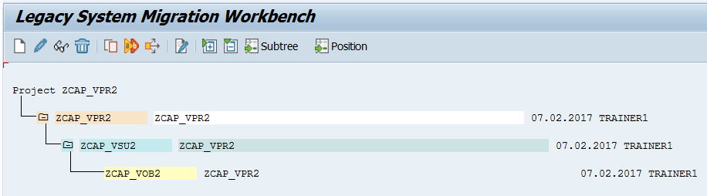
LSMW - Procedure
Project
An ID to name the data transfer project
Sub Project
An ID used as a further structuring attribute
Object
An ID to name the business object
Notes:
At the initial screen, ‘All Objects’ provides a list of all projects created already.
‘My Objects’ displays a list of all objects you created personally.
‘All Project Objects’ displays all objects of the selected project as tree structure. ‘Project Documentation’ displays any documentation written for the individual pop-ups and processing steps.
You can print the project documentation out, send it and save it in various file formats.
Select ‘Documentation’ to enter your notes. After clicking, a popup is displayed in which you can write down your personal documentation.
By clicking the button execute or pressing the F8 key on your keyboard you go to the object, you selected.
By clicking the button create a new object for the selected project and subproject with the name entered in the object field is created.
By positioning the cursor on an entry and clicking on the button documentation, you can add change or delete comments.

Slide 9
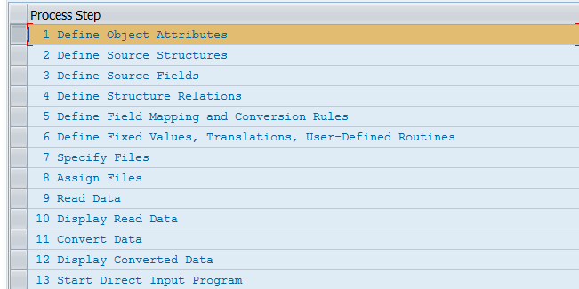
LSMW – Procedure (Contd.).
Upon creating the project, subproject and Objects, execute and the process steps appear as follows:
Notes:
The number of process steps is dynamic and shall depend on factors like input method.
By clicking the ‘User menu’ button one can select – deselect the Process steps.
To proceed through the processing steps one needs to start from the first one and execute each of them.
A step can be skipped by selecting the next available processing steps push button.

Slide 10
Define Object Attributes
The object type and import technique are selected

Slide 11
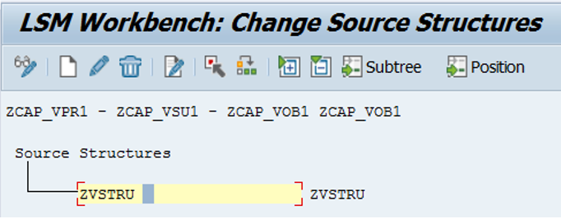
Define Source Structure
Define the structures of the object with name, description.
Notes:
In the step ‘Maintain Source Structures’ you define the structures of the object with name, description and the hierarchical relationships:
Click on Change button. You can now define, change, reassign or delete structures. All these functions are available via pushbuttons.
When you define more than one structure, a popup is displayed querying the relations between the structures: equal/subordinate?

Slide 12
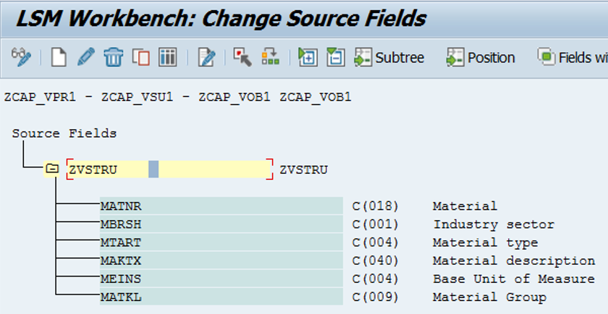
Define Source Fields
In the step ‘Maintain Source Fields’, fields are created and maintained for the source structure defined in the preceding step
Use source fieldnames with the same names as the target fieldnames as much as possible, because it allows you to use the ‘auto-field mapping’ function in step ‘Maintain field mapping and conversion rules’.
Notes:
Different possible ways of defining and maintaining the source fields:
Make sure that you are in change mode and the cursor is positioned on a source structure or an existing source field
1.Create Individual source fields - By clicking on the button ‘Create source field’ you can specify the field name, field label, field length and field type.
2. Maintain Source Fields in Table Form – Clicking on the ‘Table Maintenance’ button displays the fields in a tabular format.

Slide 13
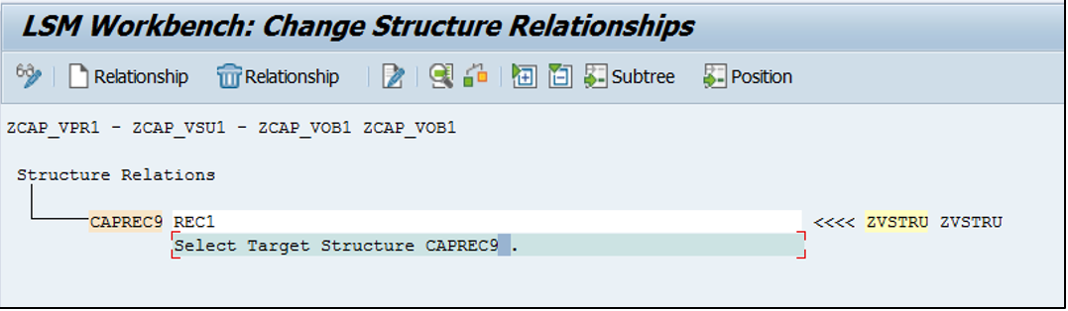
Define Structure Relationships
The structural relationships define the relationships between source and target structures.
Since there is only one source and target, the relationship is maintained
Notes:
In the step ‘Maintain Structure Relations’, the structural relationships between source and target structures are defined. The possible target structures are defined during the selection of the object type and the import technique
To define structural relationships, position the cursor on the field target structures. Clicking create Relationship button opens a window that displays the existing source structures for selection
If you want to change the relation, remove the existing relation first. In addition, you can use Check to check the structural relationships for errors

Slide 14
Maintain Field Mapping and Conversion Rules
Assign source fields to target fields and define how the field contents will be converted.
In the step ‘Maintain Field Mapping and Conversion Rules’, you assign source fields to target fields and define how the field contents will be converted
All fields of target structure, which you selected in the previous step, will be displayed.

Slide 15
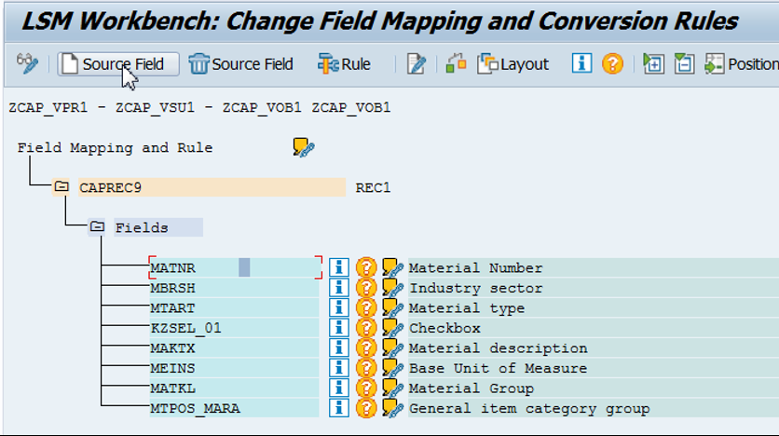
Maintain Field Mapping and Conversion Rules
To assign a source field, position the cursor on a target field in the tree structure and select Assign source field
This displays a list of all available source fields for selection. You can assign the fields by double-clicking on them as well

Slide 16
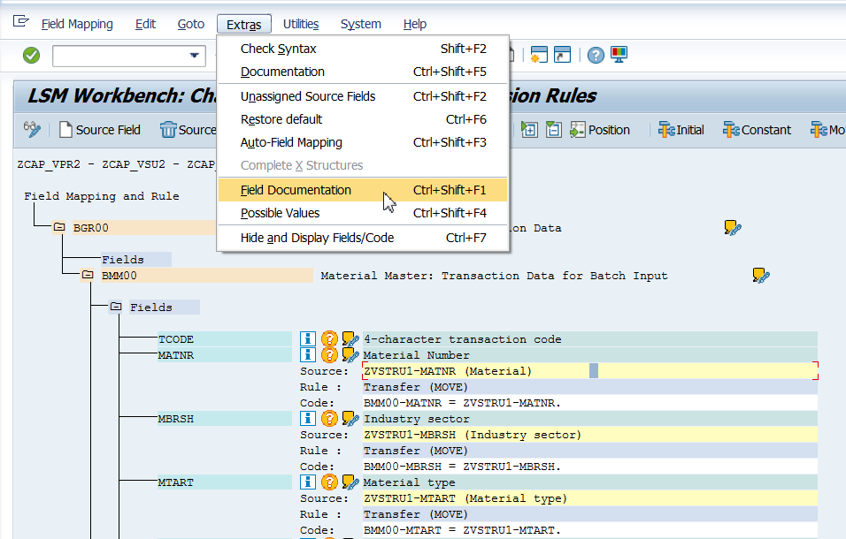
Maintain Field Mapping and Conversion Rules
Notes:
The following functions are available:
Field documentation :
Displays a short documentation for the target field the cursor is positioned on. The documentation may branch off to further information.
Possible values:
Displays a selection list of all values possible for this target field.
Longtext / Documentation:
Maintenance of the documentation for a field etc.
Assign a source field:
To assign a source field, position the cursor on a target field in the tree structure and select Assign source field. This displays a list of all available source fields for selection. The fields can be assigned by double-clicking on them.
Remove the assignment of a source field:
To remove a source field assigned before, position the cursor on a target field in the tree structure and select Remove source field.
If one source field has been assigned only, this field is removed.
If several source fields have been assigned, a list of all source fields assigned is displayed for selection. The corresponding source field can then be selected by double-clicking on it.
After assigning the source fields, define the conversion rules.
The default rule is "Move".

Slide 17

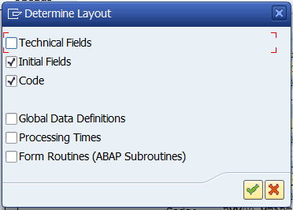
Maintain Field Mapping and Conversion Rules
Layout determination
Notes:
The layout of the ‘Maintain field mapping’ screen can be determined. i.e. we can decide whether the ‘Global data’, ‘Technical fields’ should be displayed

Slide 18
Maintain Fixed Values, Translations and User-written Routines
Fixed value: Here you can specify length, type, flag for lowercase/uppercase and value in addition to the description.
Translation values: Here you specify the value table to be used during translation. The values can be uploaded from a PC file.
Process the reusable rules of a project

Slide 19
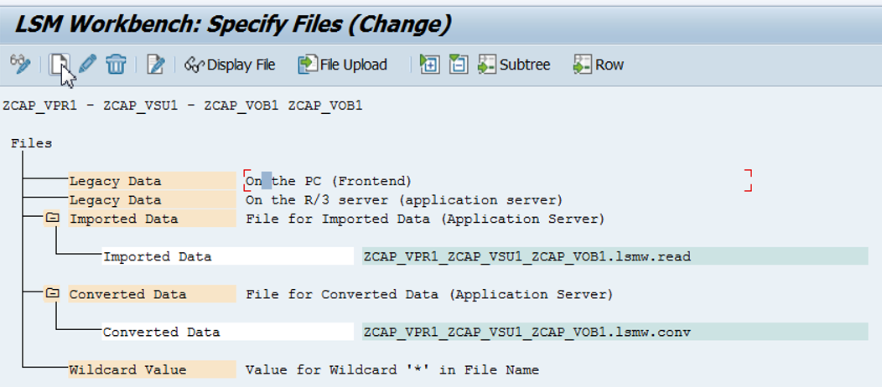
Specify Files
This step describes all files to be used in the following steps:
Notes:
In the step ‘Specify Files’, you describe all files to be used
If your legacy data is on the PC: In change mode, position the cursor on the line ‘Legacy data On the PC (Front-end)’. Select Add entry. A popup is displayed. Specify file path, file name and description and other properties
If your legacy data is on the R/3 server: In change mode, position the cursor on the line ‘ Legacy data On the R/3 server (application server)’. Select Add entry. A popup is displayed. Specify file path, file name and description and other properties
File for Imported data: Here, the file name is entered with file extension ’.lsmw.read’.
File for Converted data: Here, the file name is entered with file extension ’.lsmw.conv’. This file will contain all your converted data after applying the conversion rules if any.

Slide 20
Assign Files
Assign defined files to the source structures
Notes:
In the step ‘Assign Files’, you can assign the file name in step 7 declared as source file to the target structure defined in step 2 . If you click on the Assign File button, after clicking once on a target structure (in yellow), LSMW displays the list of available source files. If you click on the Delete Assignment button, after clicking once on a target structure (in yellow), the source file is deleted from the target structure

Slide 21
Read Data
Can display all or a part of the read data in table form .
To process all data belonging to an object, click on Execute.
To migrate a part of the data only, limit the number of data to be migrated in field "General selection parameters". Make the selection in field "Transaction number" from "... to ...". Multiple selection is possible.
In addition, two check boxes are offered:
Amount field: Amount fields are converted into calculation format (with decimal point).
Date field: Date fields are converted into internal format (YYYYMMDD).

Slide 22
Display Read Data
Display all or a part of the read data in table form.
Clicking on a line displays all information for this line in a clear way.
Change display allows to select either a one-line or multi-line view.
Display color palette displays the colors for the individual hierarchy levels.

Slide 23
Convert Data
With regard to operation, this work step essentially corresponds to work step "Read Data".
If data selection is not to be made, confirm the process by clicking on Execute. Otherwise, make the selection in field "Transaction number" from "...to...". Here, multiple selection of transaction numbers is possible as well.
If one or several source fields are marked as selection parameters when defining the source fields, these fields are also offered as selection parameters.

Slide 24
Display Converted Data
Display Converted Data
The display the data that is converted.

Slide 25
Generate Batch Input Session
The standard batch input program belonging to the object is directly called.
The name of the file with the converted data is already proposed.
The batch input sessions to be generated are named after the LSMW object.

Slide 26
LSMW – Procedure
Run Batch Input Session
The program goes to SAP standard transaction SM35.
Follow the procedure to run the session (which is already discussed in the Session method)
Import Data with Direct Input
Depending on the object type, either the standard direct input program belonging to the object is called or select a direct input program or a direct input transaction.
Start Direct Input Session
Depending on the object type, either the standard direct input program belonging to the object is called or a direct input program can be selected or a direct input transaction.

Slide 27
Demo: LSMW

Slide 28
Demo: Direct Input Method

Slide 29
Summary
In this lesson, you have learnt:
How to Use LSMW Data Transfer

Slide 30
Review Question
Question 1: In the specify file step of LSMW, filese can only be selected from the Application Server.
True/False
Question 2: In Standard/Direct Input method of LSMW all fields of a transaction are always available for reprocessing.

